Slide 1
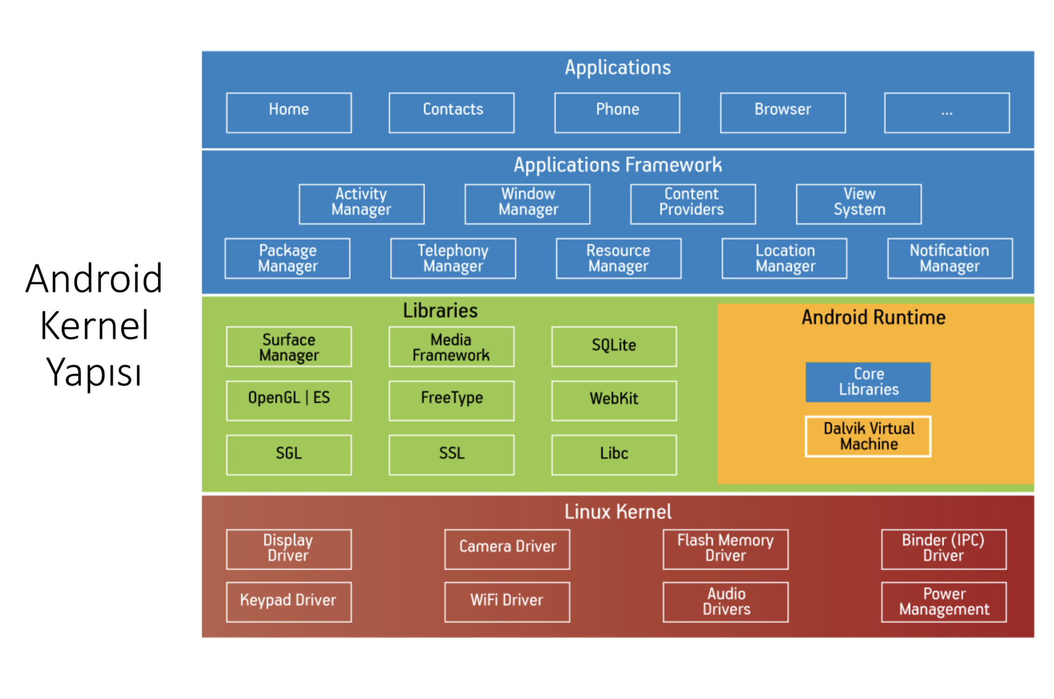

Slide 2
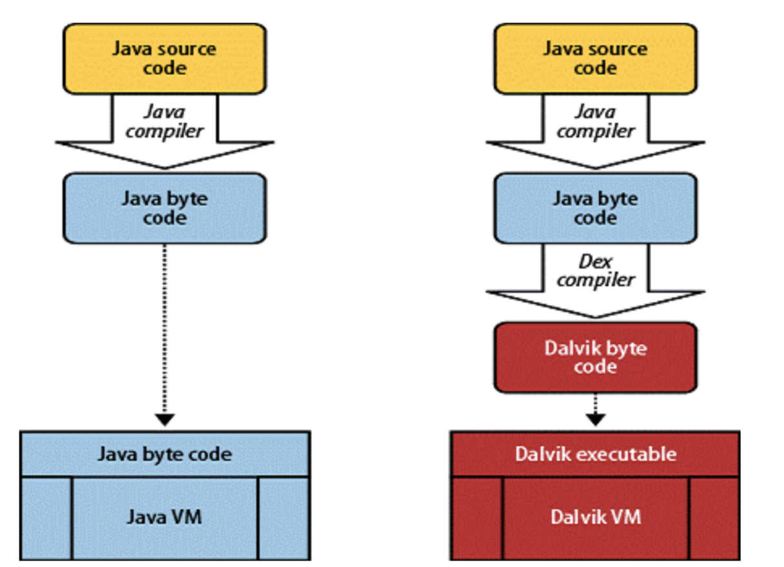
(.dex – dalvik executable)
ART Compiler is available instead of DALVIK after 4.4

Slide 3
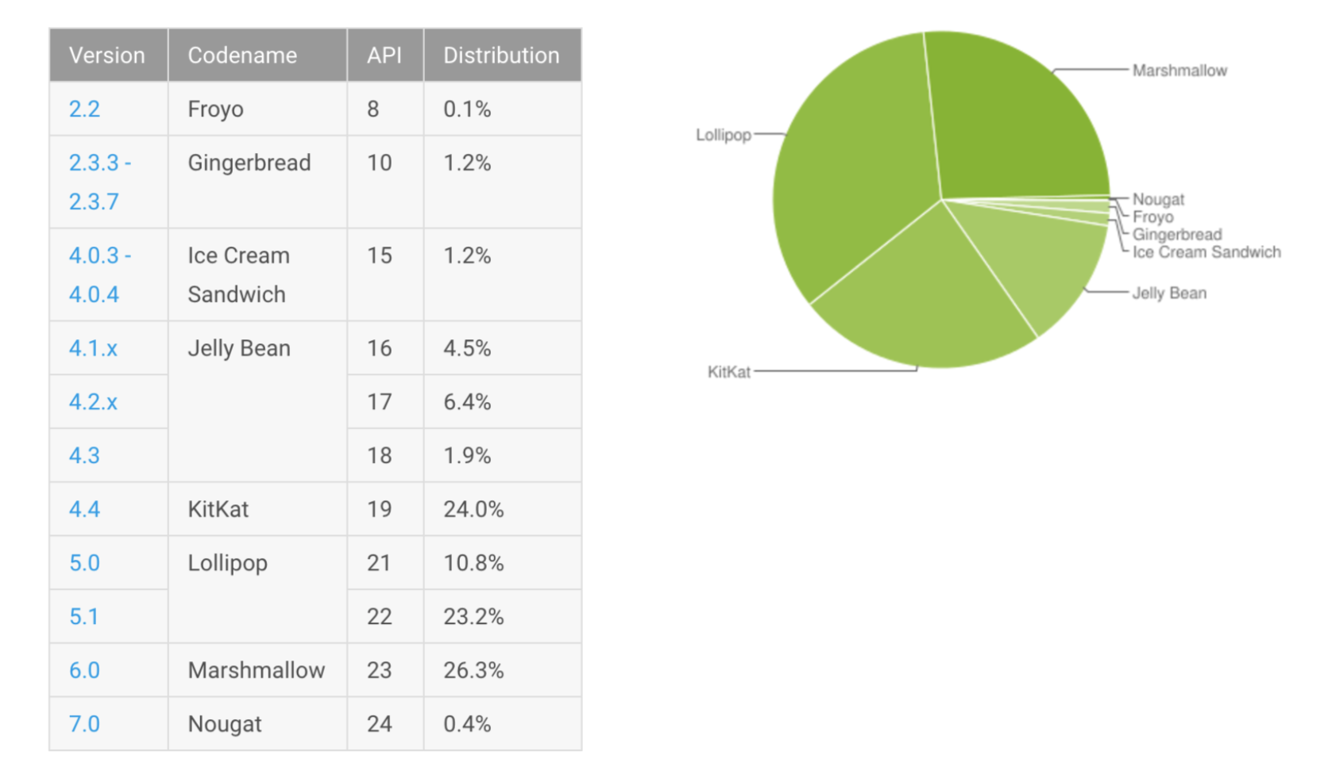

Slide 4
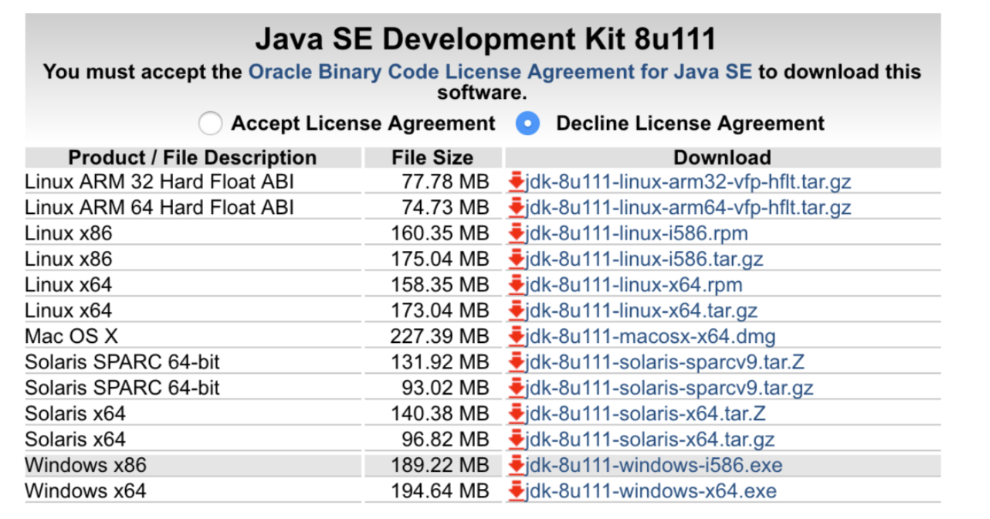
Android Studio ttps://developer.android.com/studio/index.html#downloads
JDK : http://www.oracle.com/technetwork/java/javase/downloads/jdk8- downloads-2133151.html

Slide 5
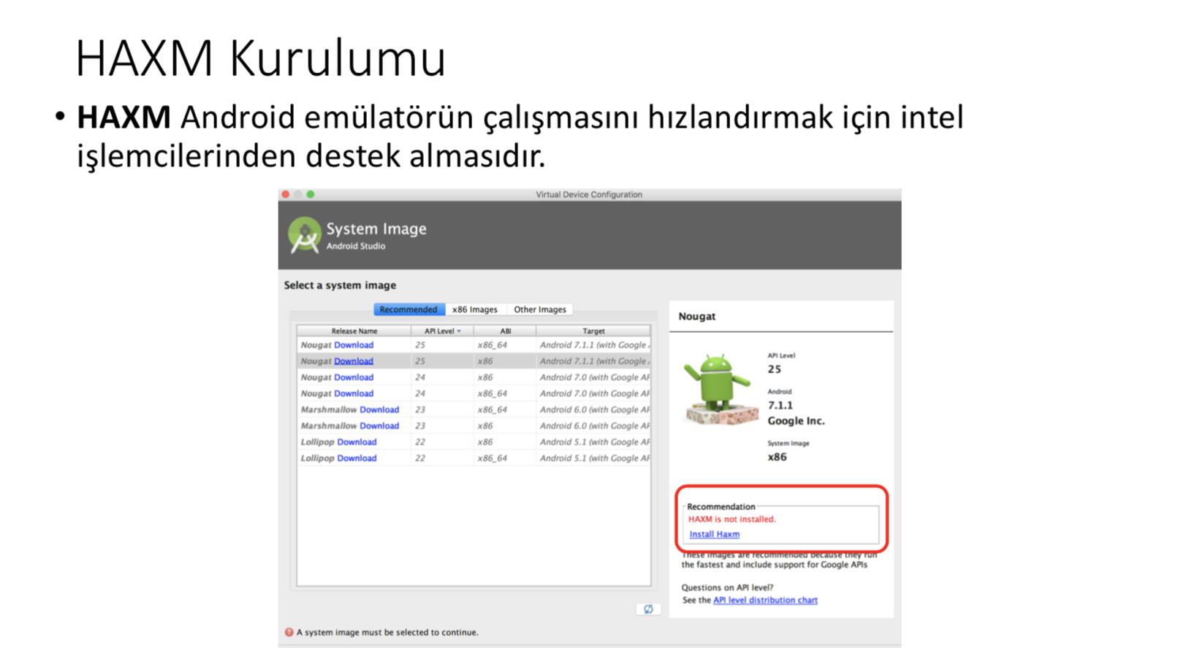

Slide 6
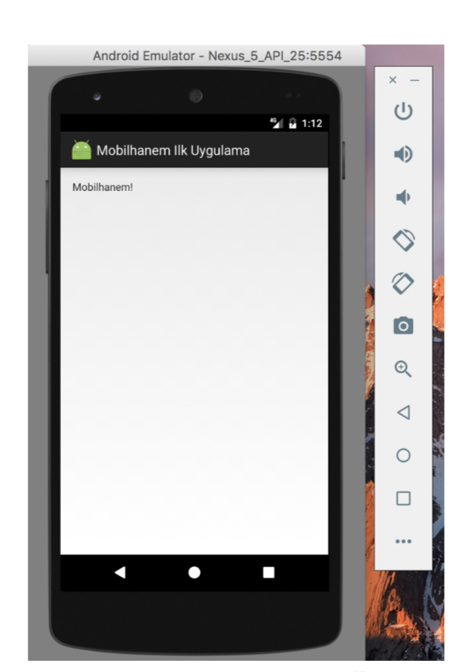
AVD ( Android Virtual Device )(Android Sanal Cihaz)
Geliştirdiğimiz uygulamaların çalışmasını görebilmek için kullandığımız sanal cihazlardır.

Slide 7
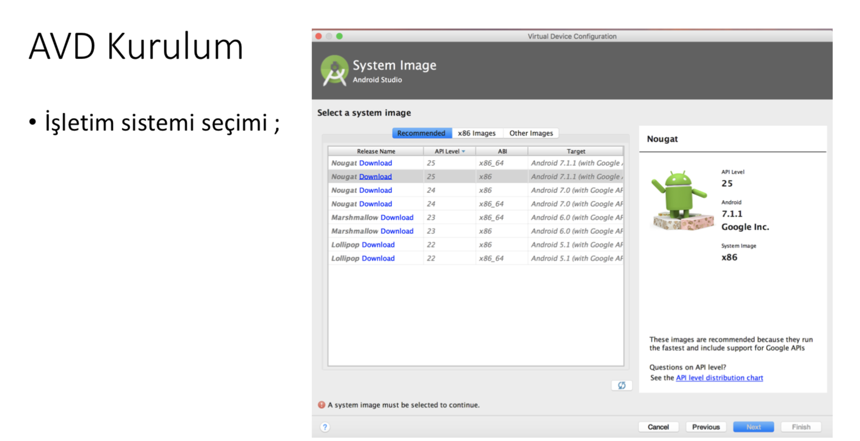

Slide 8
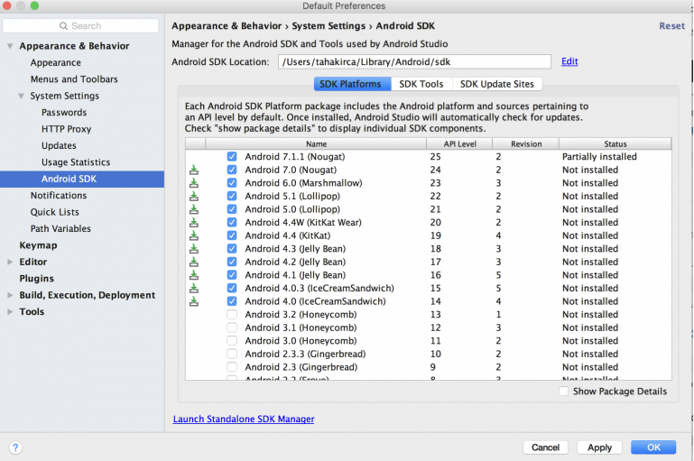

Slide 9
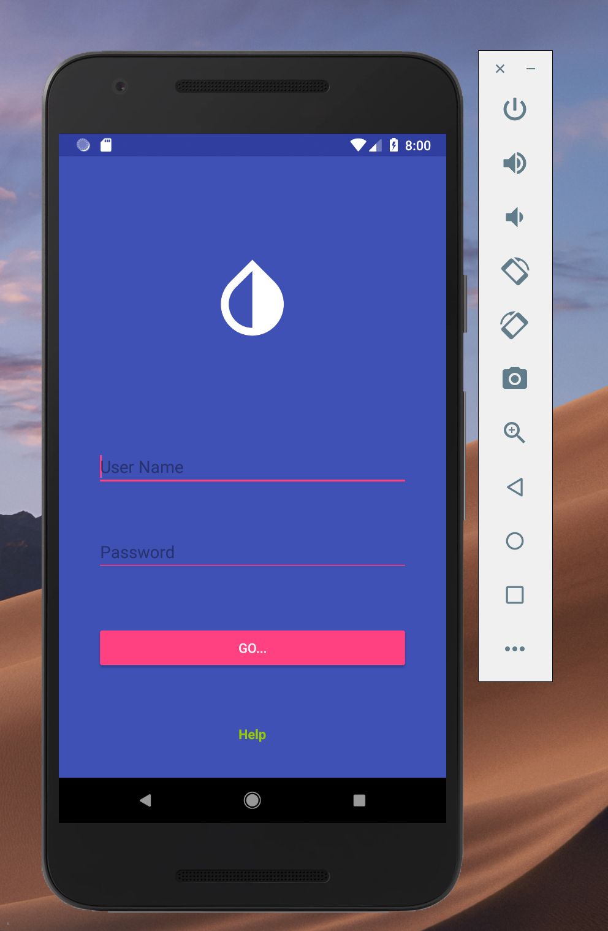
LOGIN LAYOUT DESGIN

